Slide 1
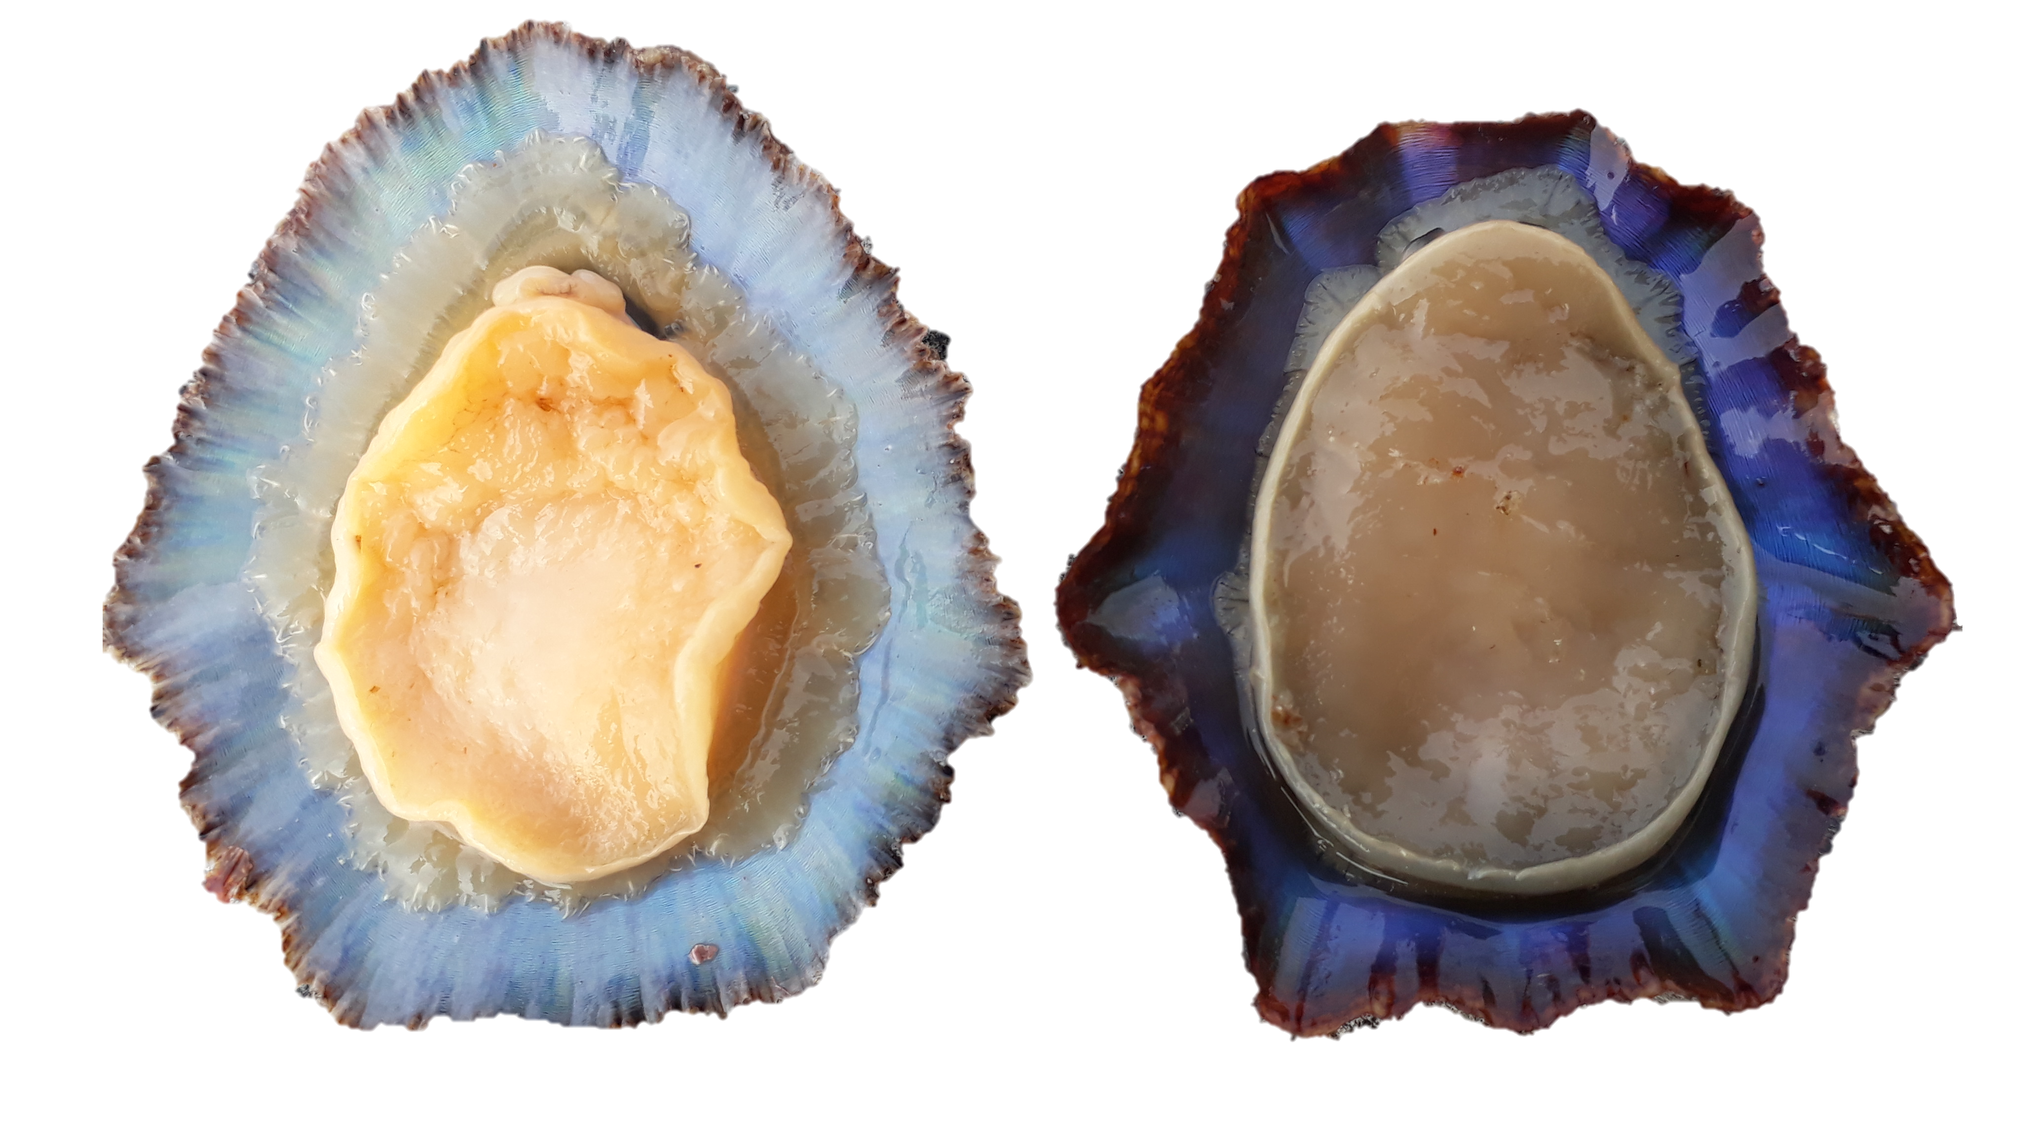
Early Verliger
(before torsion)
Late Verliger
(posttorsional larval stage)
pediveliger (last larval stage)
EGG
Trochophore
8-9
hours post fertilization (hpf)
36-41 hpf
Abbreviations:
act, apical ciliary tuft;
alr, accessory larval retractor;
ft, anlage of foot;
Hpf, hours post fertilization
lmf, longitudinal mantle fibres,
lsm, left shell muscle,
mf, mantle fold;
mlr, main larval retractor;
op, operculum;
pt, prototroch.
pp, pedal plexus,
rsm, right shell muscle,
te, cephalic tentacle,
tmf, transversal mantle fibres,
vh, visceral hump,
vr, velum (muscle)
51 hpf
54 hpf
147 hpf
P. aspera and P. candei: trochophores in 17h post-fertilization*
P. aspera and P. candei: trochophores in 72h post-fertilization*
P. aspera and P. candei: trochophores in 48h post-fertilization*
170 hpf
Adult
Size at first maturity = 37.5mm
Age at first maturity = 2 years
Juvenil
Metamorphosis
Defined by the:
reduction (loss) of the velum.
presence of food in the gut.
Patella aspera
Patella candei
1–5 days after
metamorphosis
*https://www.frontiersin.org/articles/10.3389/fmars.2022.884262/full#f4

